Slide 1
Graph Algorithms 11.1 – 11.5
CMPT 225

Slide 2

High-five Puzzle
At a party, some people high-five each other (no one high-fives themselves). Each of them tells you how many people they high-fived. You don’t remember what each person said, but you do remember that the sum of all the reported high-fives was 10.
How many people were at the party?
How many high-fives occurred?

Slide 3
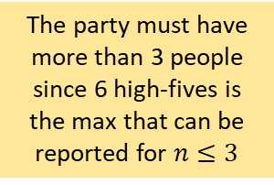
High-five Puzzle
1
n=1
At a party, some people high-five each other (no one high-fives themselves). Each of them tells you how many people they high-fived. You don’t remember what each person said, but you do remember that the sum of all the reported high-fives was 10.
How many people were at the party?
How many high-fives occurred?
1
2
n=2
The party must have more than 3 people since 6 high-fives is the max that can be reported for $n≤3$
1
2
n=3
3

Slide 4
High-five Puzzle
1
2
n=4
At a party, some people high-five each other (no one high-fives themselves). Each of them tells you how many people they high-fived. You don’t remember what each person said, but you do remember that the sum of all the reported high-fives was 10.
How many people were at the party?
How many high-fives occurred?
3
4
1
2
n=5
5
3
4

Slide 5
High-five Puzzle
n=5
1
2
1
2
5
5
3
4
3
4
5 people can shake hands in various ways such that the total sum of all ends of an edge going into a vertex is 10.
1
2
3
4
5

Slide 6

High-five Puzzle
1
2
n=4
At a party, some people high-five each other (no one high-fives themselves). Each of them tells you how many people they high-fived. You don’t remember what each person said, but you do remember that the sum of all the reported high-fives was 10.
How many people were at the party?
How many high-fives occurred?
3
4
$$≥4$$
n=5
1
2
As long as there are 4 or more people, we can draw 5 edges, where the sum of all the ends of the edges is 10.
5
3
4

Slide 7
High-five Puzzle
1
2
n=4
At a party, some people high-five each other (no one high-fives themselves). Each of them tells you how many people they high-fived. You don’t remember what each person said, but you do remember that the sum of all the reported high-fives was 10.
How many people were at the party?
How many high-fives occurred?
3
4
$$≥4$$
n=5
1
2
exactly 5
5
3
4

Slide 8
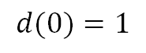
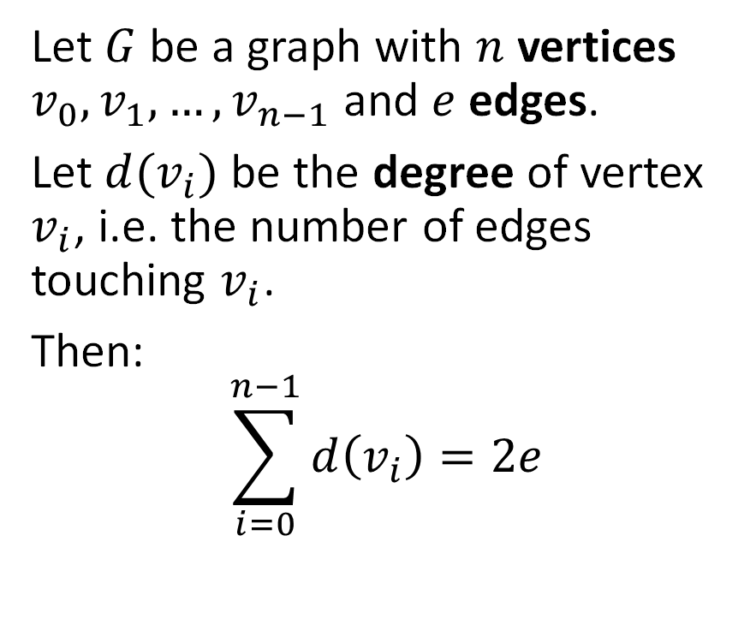
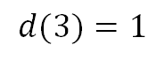
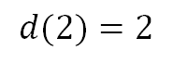
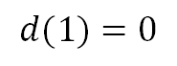
Handshaking Lemma
0
$$d(0)=1$$
Let $G$ be a graph with $n$ vertices $v_{0}, v_{1}, …, v_{n−1}$ and $e$ edges.
Let $d(v_{i})$ be the degree of vertex $v_{i}$, i.e. the number of edges touching $v_{i}$.
Then:
$$\sum_{i=0}^{n−1}{d\left(v_{i}\right)=2e}$$
$$d(1)=0$$
1
$$d(2)=2$$
2
$$d(3)=1$$
3
Justification: every edge contributes 2 to the degree count.

Slide 9
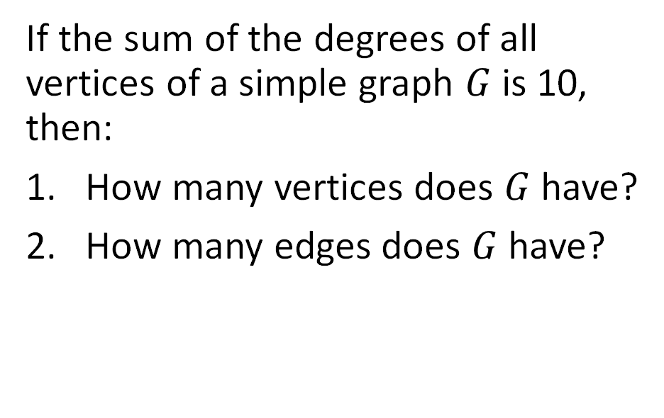
High-five Puzzle
At a party, some people high-five each other (no one high-fives themselves). Each of them tells you how many people they high-fived. You don’t remember what each person said, but you do remember that the sum of all the reported high-fives was 10.
How many people were at the party?
How many high-fives occurred?
If the sum of the degrees of all vertices of a simple graph $G$ is 10, then:
How many vertices does $G$ have?
How many edges does $G$ have?

Slide 10
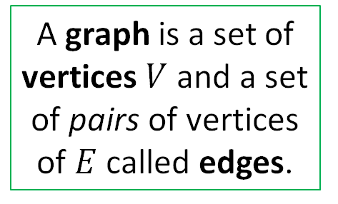
Basic Definitions
a
b
A graph is a set of vertices $V$ and a set of pairs of vertices of $E$ called edges.
c
e
d
V =
E =

Slide 11
Basic Definitions
a
b
A graph is a set of vertices $V$ and a set of pairs of vertices of $E$ called edges.
c
e
d
V = {a, b, c, d, e}
E = {ac, ad, ec}

Slide 12
Basic Definitions
a
b
A graph is a set of vertices $V$ and a set of pairs of vertices of $E$ called edges.
This is an undirected graph, E.g. ec and ce are the same edge
c
e
d
V = {a, b, c, d, e}
E = {ac, ad, ec}

Slide 13
Basic Definitions
a
Directed graphs are called digraphs for short.
b
A graph is a set of vertices $V$ and a set of pairs of vertices of $E$ called edges.
This is a directed graph, since the edges are directed.
c
e
The edges are directed.
E.g. ec and ce are different edges.
d
V = {a, b, c, d, e}
E =

Slide 14
Basic Definitions
a
Directed graphs are called digraphs for short.
b
A graph is a set of vertices $V$ and a set of pairs of vertices of $E$ called edges.
This is a directed graph, since the edges are directed.
c
e
The edges are directed.
E.g. ec and ce are different edges.
d
V = {a, b, c, d, e}
E = {ac, ce, dc, da, ec }

Slide 15
Basic Definitions
A graph is a set of vertices $V$ and a set of pairs of vertices of $E$ called edges.
Depending on the application, a graph might have:
A self-loop an edge connected to the same vertex
More than one edge between vertices:
a
A graph with no self-loops and at most one edge between each vertex pair is called a simple graph.
e
c

Slide 16
Basic Definitions
a
b
A graph is a set of vertices $V$ and a set of pairs of vertices of $E$ called edges.
A path is an alternating sequence of vertices and edges, starting and ending with a vertex, such that each edge is connected to the vertex before and after it.
c
e
d
Write 3 paths from e to d.

Slide 17
Basic Definitions
a
b
A graph is a set of vertices $V$ and a set of pairs of vertices of $E$ called edges.
A path is an alternating sequence of vertices and edges, starting and ending with a vertex, such that each edge is connected to the vertex before and after it.
c
e
d
Write 3 paths from e to d.
A simple path has no repeated vertices.
Path 1: ecad Path 2: ecd Path 3: ecdacdacd

Slide 18
Basic Definitions
a
b
A graph is a set of vertices $V$ and a set of pairs of vertices of $E$ called edges.
A cycle is a path where there are at least two different ways to get to the different vertices on the path.
c
e
d
A path is an alternating sequence of vertices and edges, starting and ending with a vertex, such that each edge is connected to the vertex before and after it.
Which of these paths is a cycle?
Path 1: ecad Path 2: ecd Path 3: ecdacd
A simple path has no repeated vertices.

Slide 19
Basic Definitions
a
b
A graph is a set of vertices $V$ and a set of pairs of vertices of $E$ called edges.
A cycle is a path with a loop between 2 or more vertices.
c
e
d
A path is an alternating sequence of vertices and edges, starting and ending with a vertex, such that each edge is connected to the vertex before and after it.
Which of these paths is a cycle?
Path 1: ecad Path 2: ecd Path 3: ecdacd
This is a cycle.
A simple path has no repeated vertices.

Slide 20
Basic Definitions
a
b
A graph is a set of vertices $V$ and a set of pairs of vertices of $E$ called edges.
A graph is connected if for any two vertices there is a path between them.
c
e
d
Is this graph connected?

Slide 21
Basic Definitions
a
b
A graph is a set of vertices $V$ and a set of pairs of vertices of $E$ called edges.
A graph is connected if for any two vertices there is a path between them.
c
e
d
Is this graph connected?
No
How many different ways can you make the graph connected by adding one edge?

Slide 22
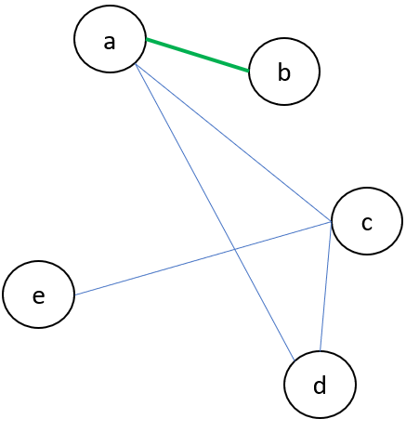
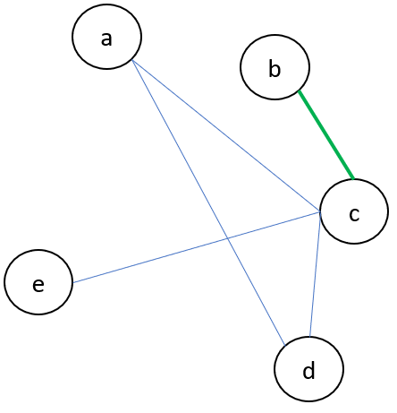
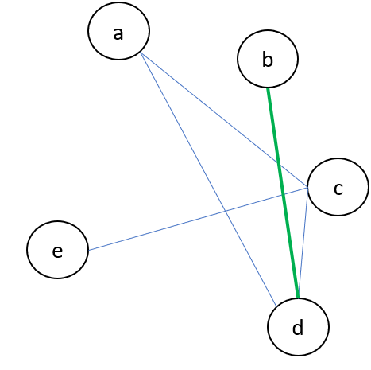
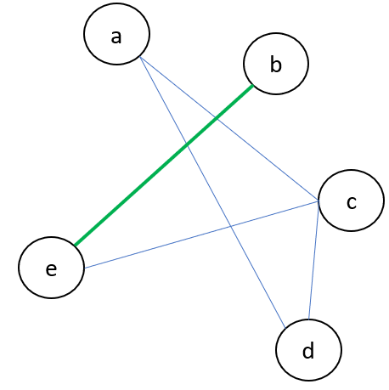
Basic Definitions
a
b
A graph is a set of vertices $V$ and a set of pairs of vertices of $E$ called edges.
A graph is connected if for any two vertices there is a path between them.
c
e
d
Is this graph connected?
No
How many different ways can you make the graph connected by adding one edge?
4 ways connect b to any of the other nodes

Slide 23
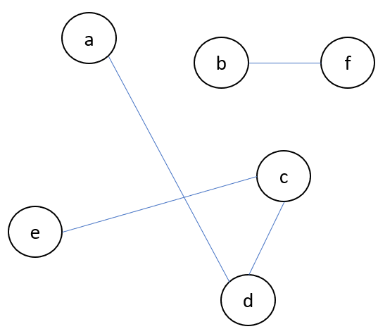
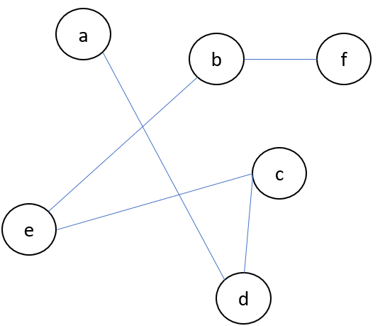
Basic Definitions
A forest is a graph with no cycles.
A graph is a set of vertices $V$ and a set of pairs of vertices of $E$ called edges.
A graph is connected if for any two vertices there is a path between them.
A tree is a connected forest.

Slide 24
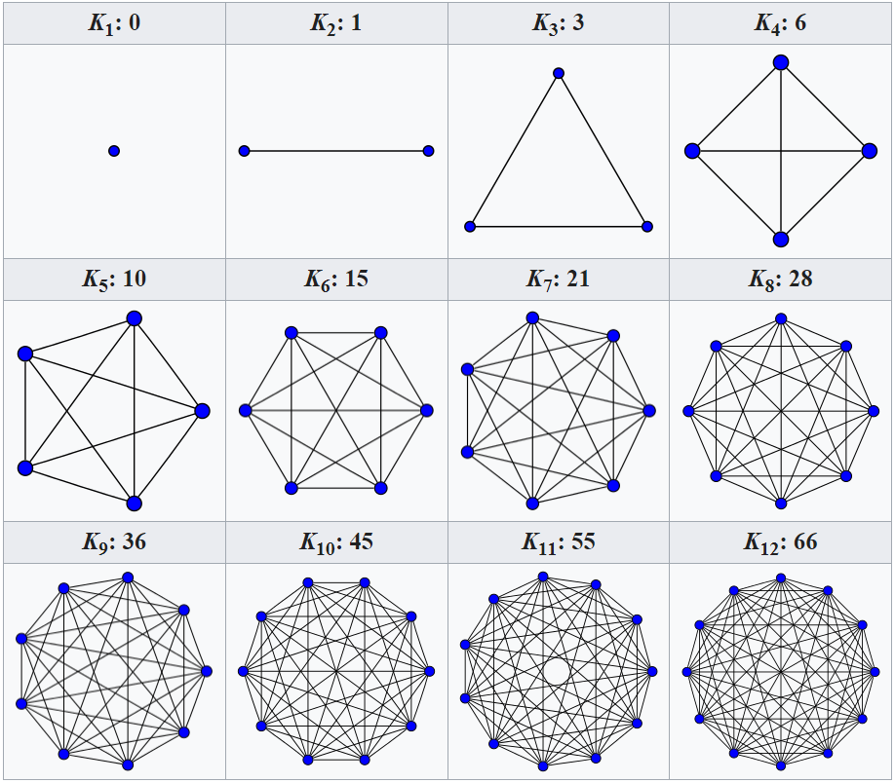
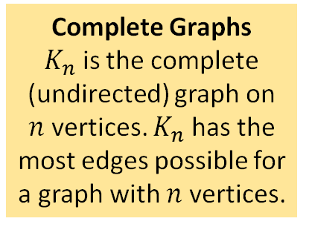
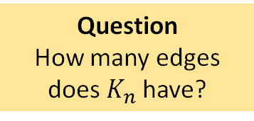
Some Special Graphs
Complete Graphs $K_{n}$ is the complete (undirected) graph on $n$ vertices. $K_{n}$ has the most edges possible for a graph with $n$ vertices.
Question
How many edges does $K_{n}$have?
Diagram from the Wikipedia article on complete graphs.

Slide 25
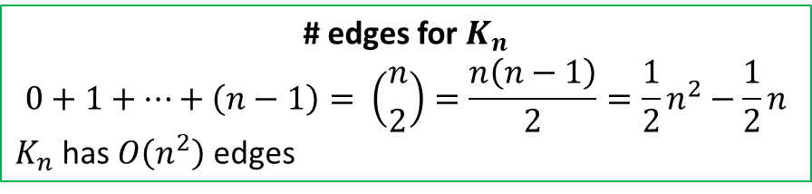
Some Special Graphs
Complete Graphs $K_{n}$ is the complete (undirected) graph on $n$ vertices. $K_{n}$ has the most edges possible for a graph with $n$ vertices.
Question
How many edges does $K_{n}$have?
# edges for $K_{n}$
$$0+1+…+\left(n−1\right)= \left({n \atop 2}\right)=\frac{n\left(n−1\right)}{2}=\frac{1}{2}n^{2}−\frac{1}{2}n$$
$K_{n}$ has $O\left(n^{2}\right)$ edges
Diagram from the Wikipedia article on complete graphs.

Slide 26
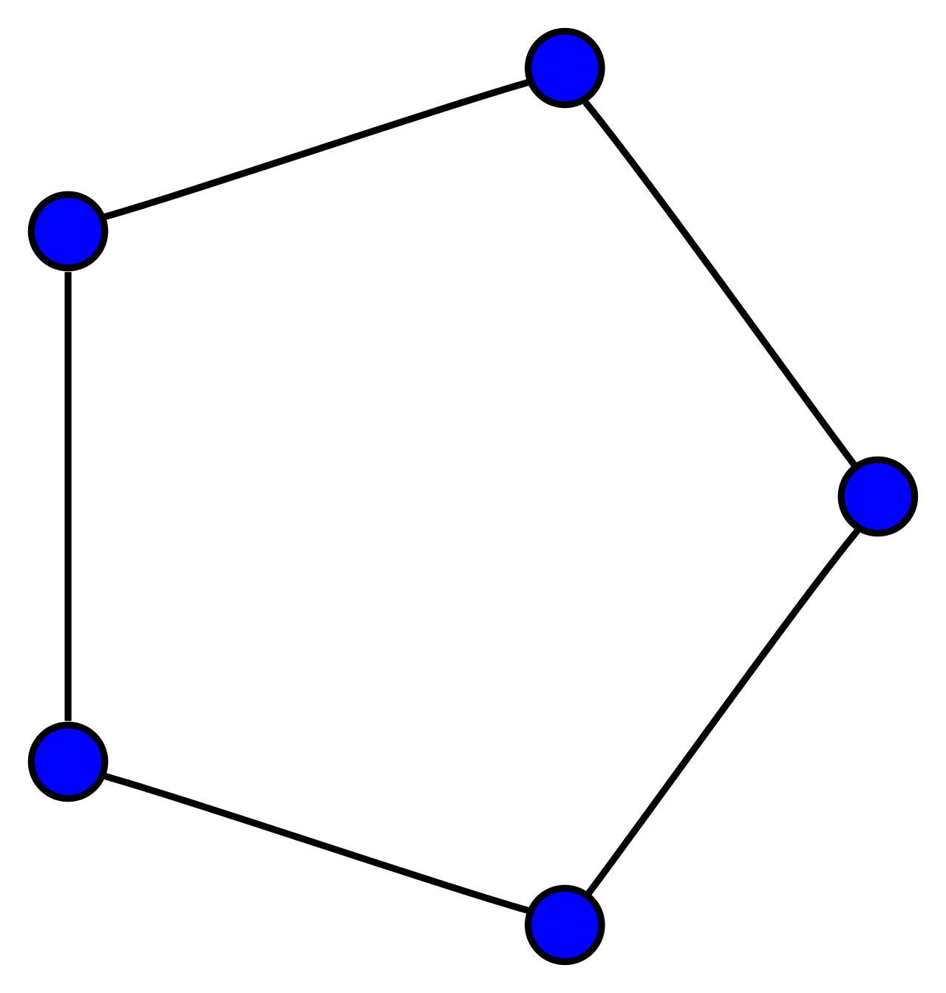
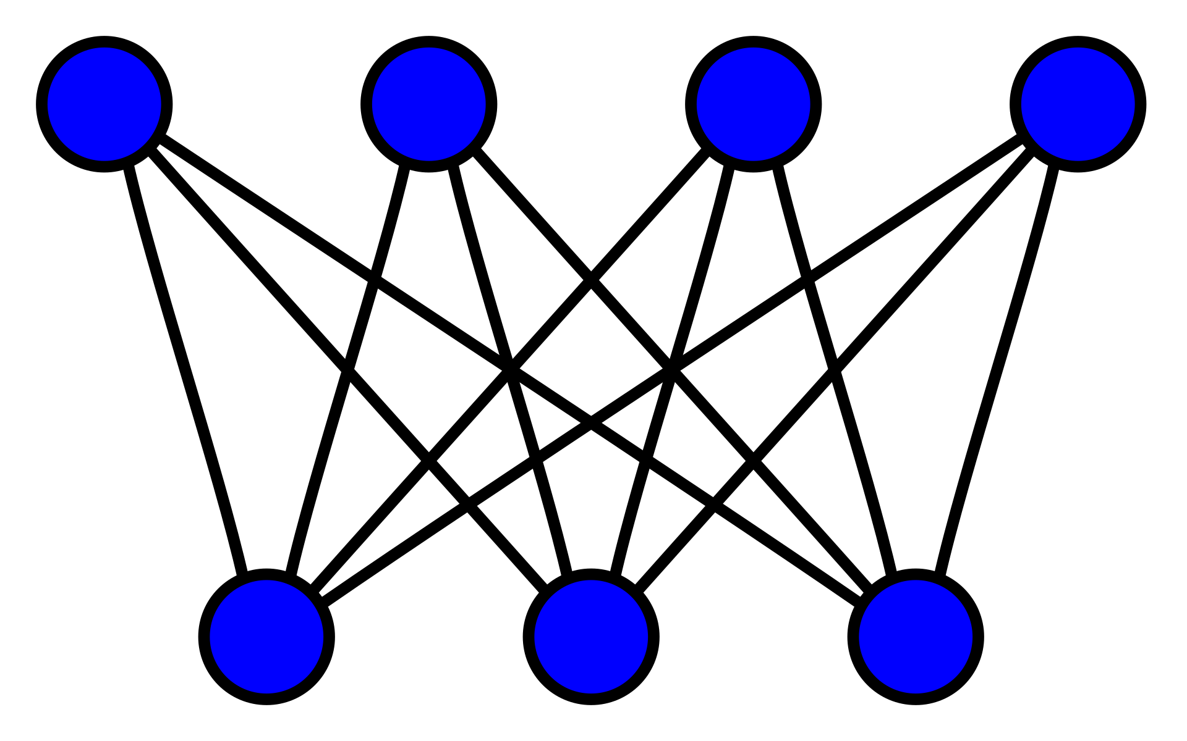
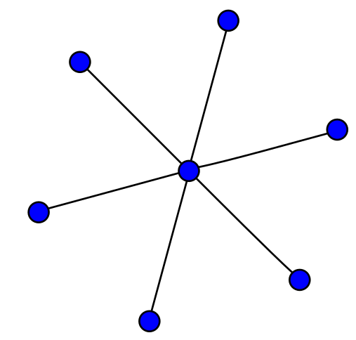
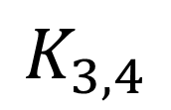
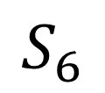
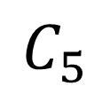
Some Special Graphs
$$K_{3,4}$$
$$C_{5}$$
$$S_{6}$$
Bipartite graph Vertices are divided into two disjoint sets, and each edge has an end in both sets.
Cycle graph A graph with a single cycle.
Star graph A graph with one internal node and all the rest are leaf nodes.
A tree!
Trees are bipartite!

Slide 27
Some Special Graphs
Question Are star graphs bipartite?
$$K_{3,4}$$
$$C_{5}$$
$$S_{6}$$
Bipartite graph Vertices are divided into two disjoint sets, and each edge has an end in both sets.
Cycle graph A graph with a single cycle.
Star graph A graph with one internal node and all the rest are leaf nodes.
A tree!
Trees are bipartite!

Slide 28
Some Special Graphs
Question Are all star graphs bipartite?
Yes! The center vertex is in one set, and the leaves are in the other.
$$K_{3,4}$$
$$C_{5}$$
$$S_{6}$$
Bipartite graph Vertices are divided into two disjoint sets, and each edge has an end in both sets.
Cycle graph A graph with a single cycle.
Star graph A graph with one internal node and all the rest are leaf nodes.
A tree!
Trees are bipartite!

Slide 29
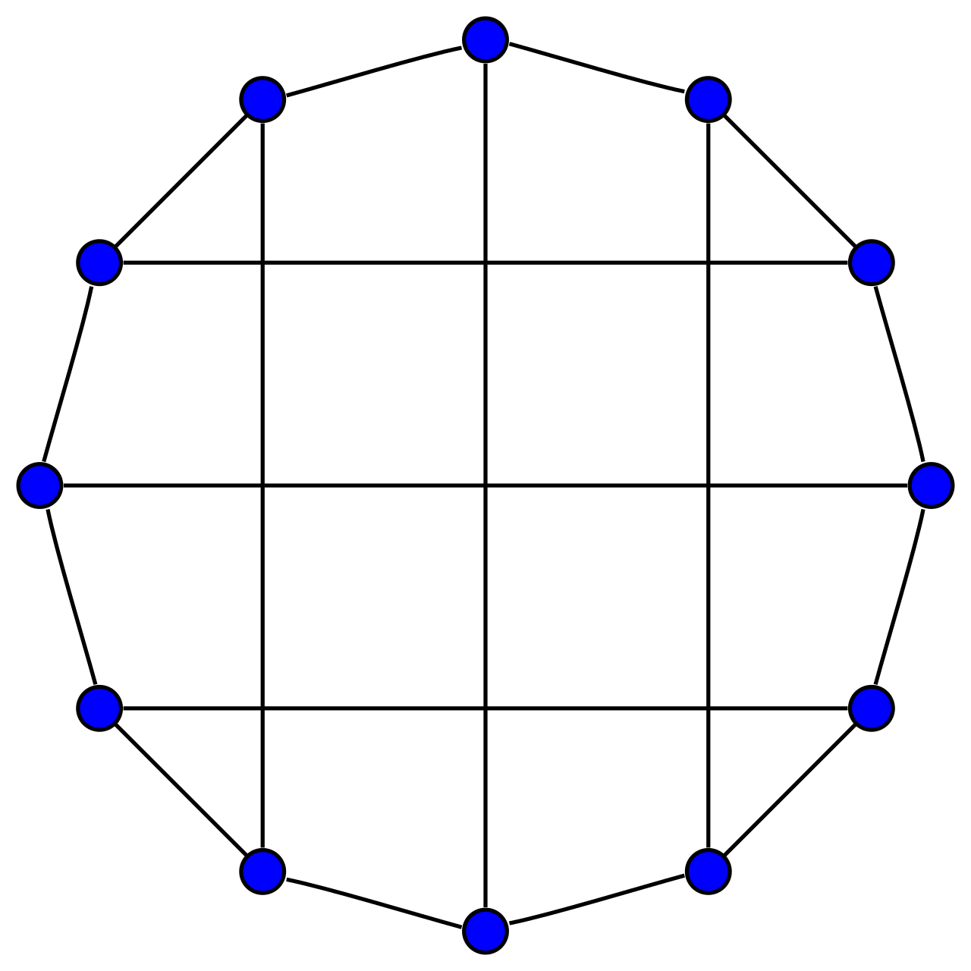
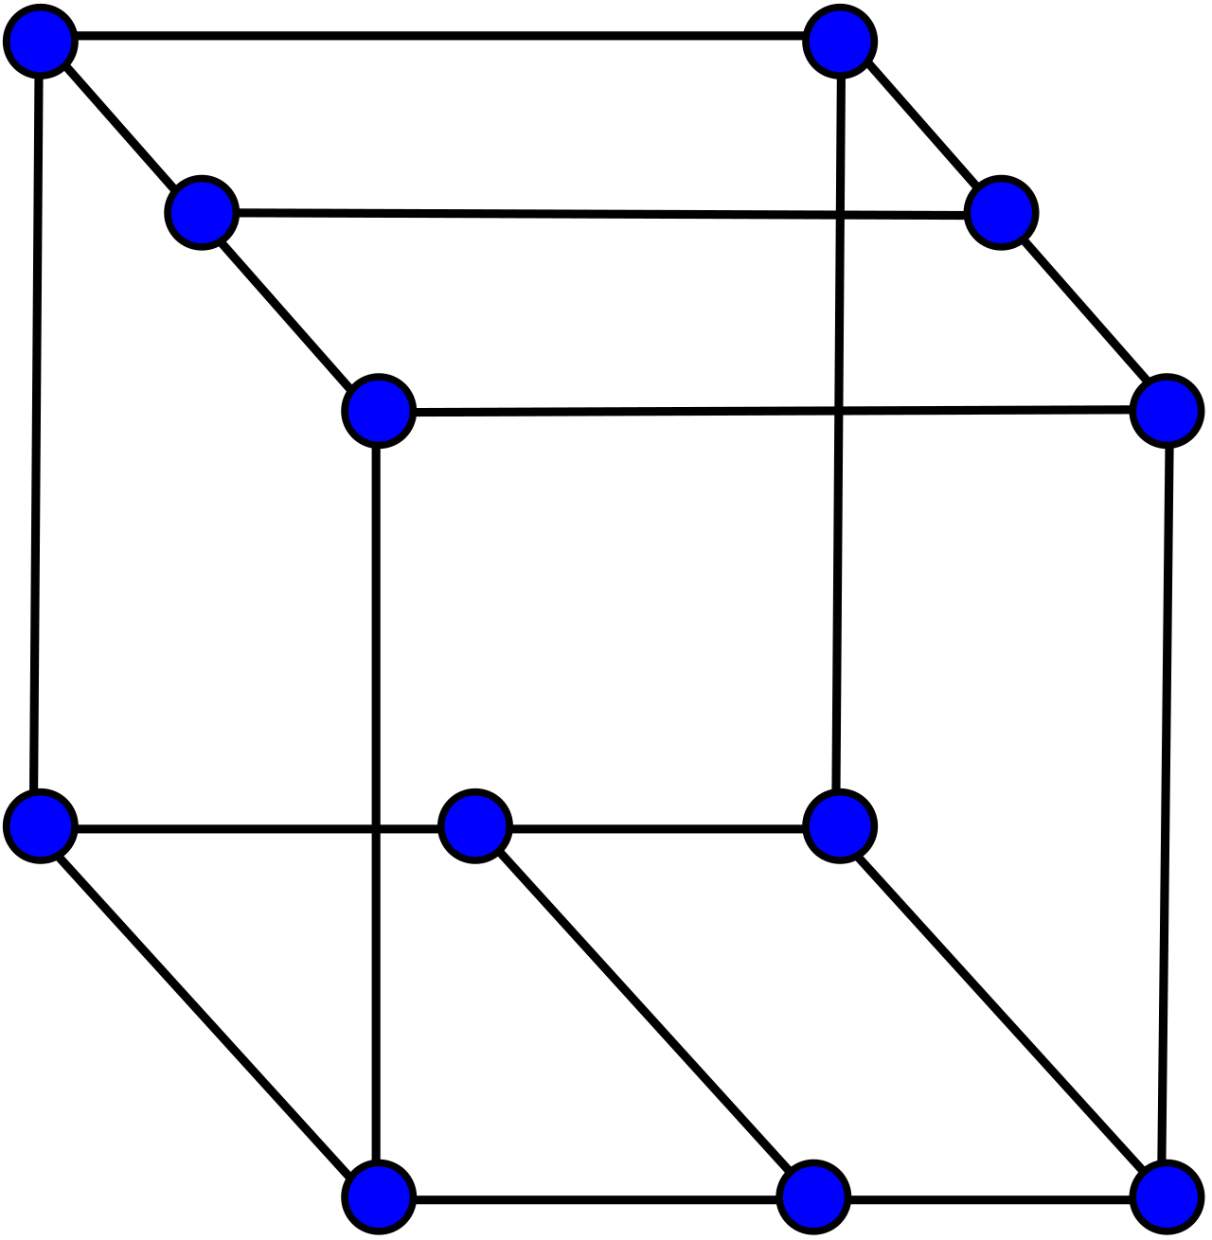
The Bidiakis Cube
All vertices have degree 3, so this is called a 3-regular graph, or cubic graph.
These two graphs are the same, they are just layed-out differently.
See Wikipedia’s list of graphs for more examples.

Slide 30
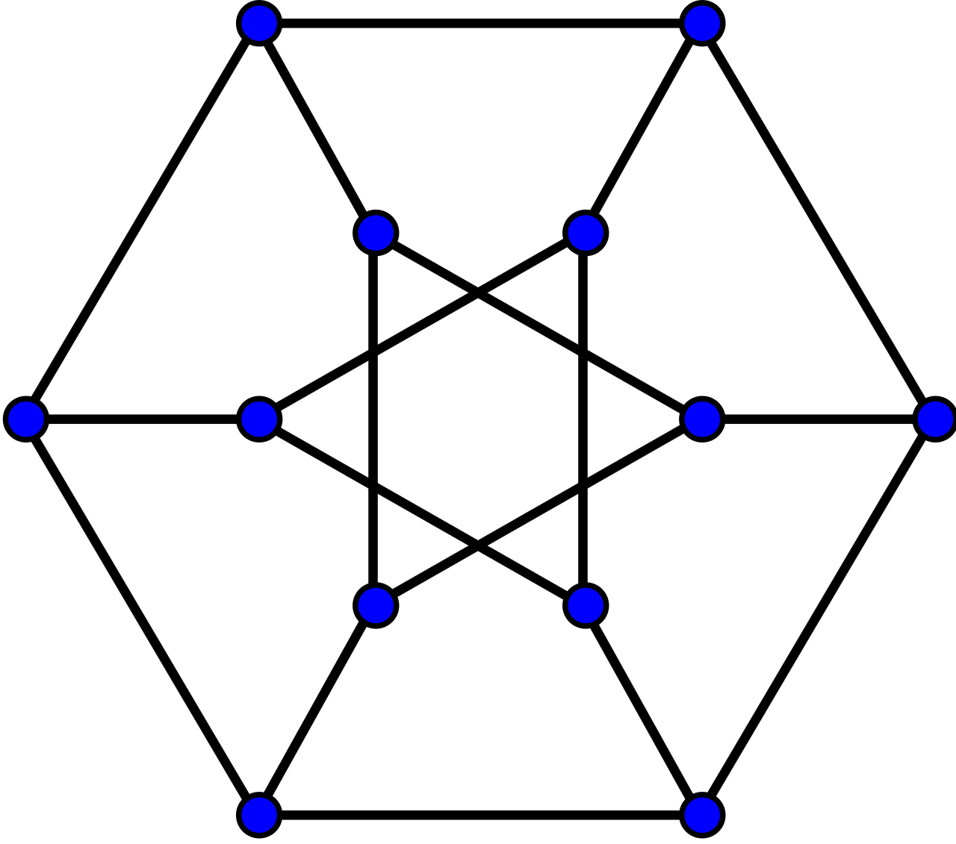
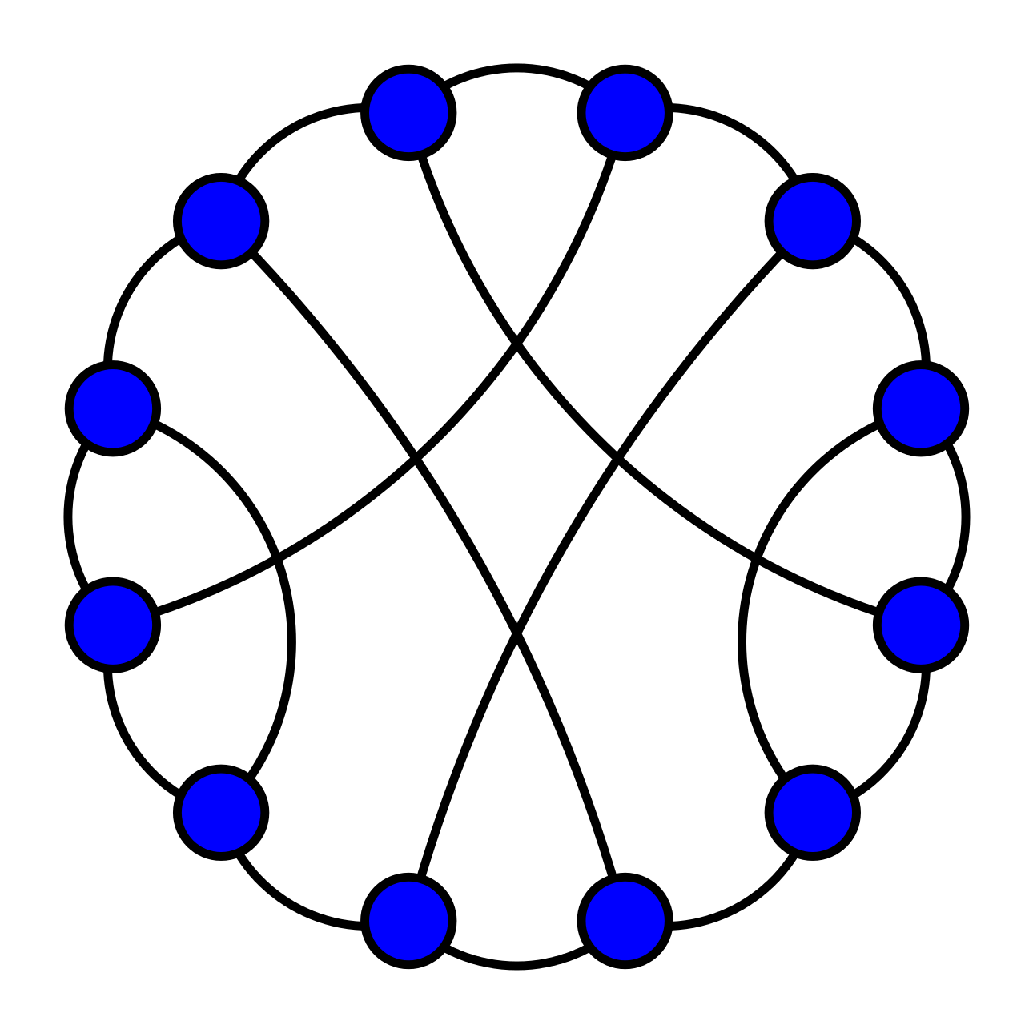
The Durer Graph
All vertices have degree 3, so this is called a 3-regular graph, or cubic graph.
These two graphs are the same, they are just layed-out differently.
See Wikipedia’s list of graphs for more examples.

Slide 31
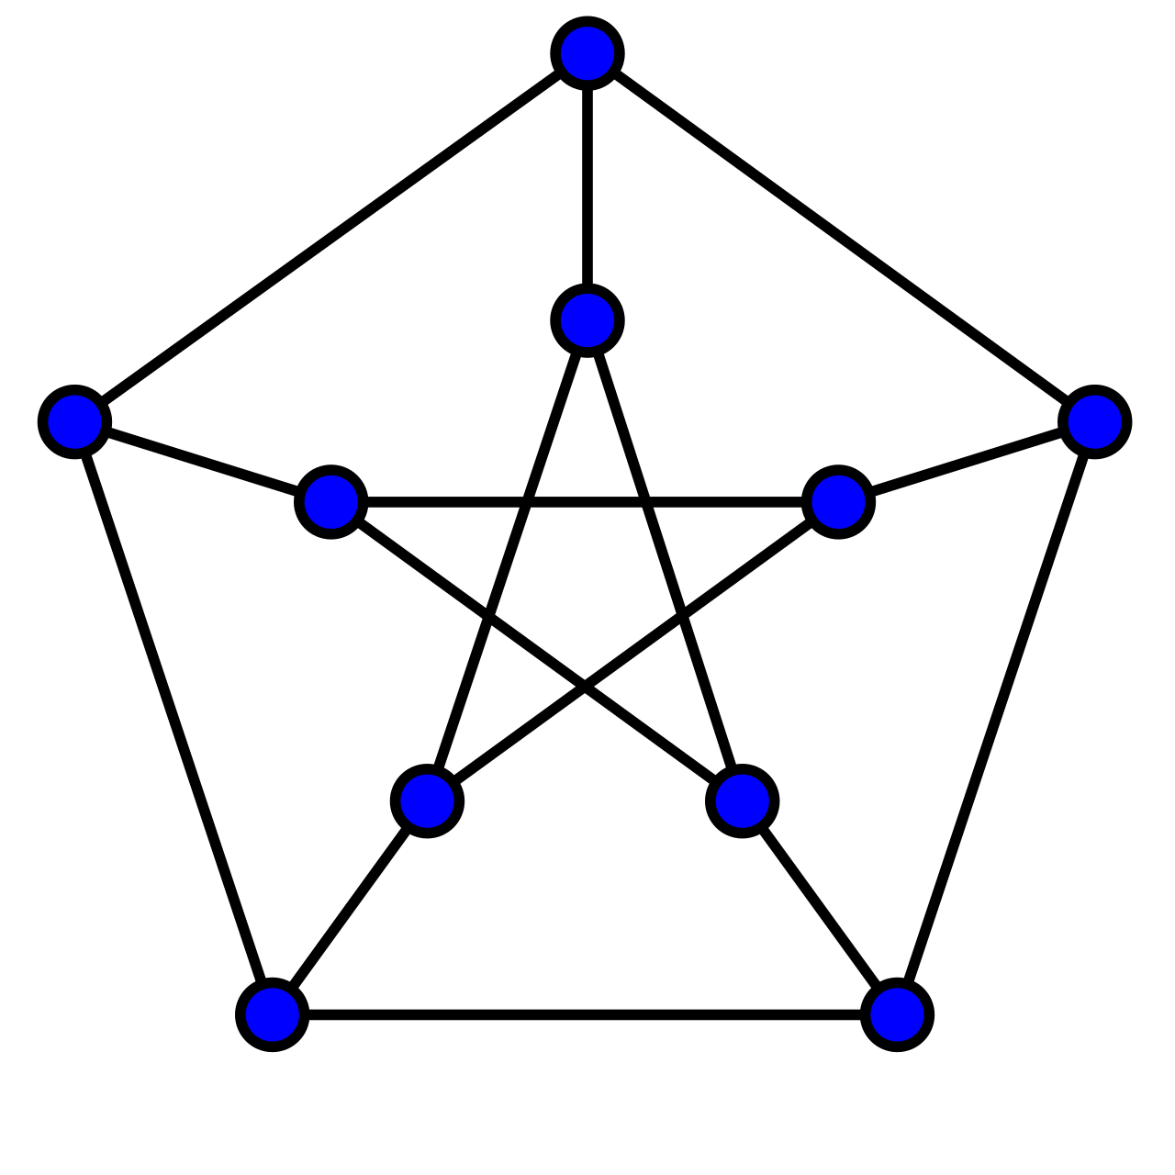
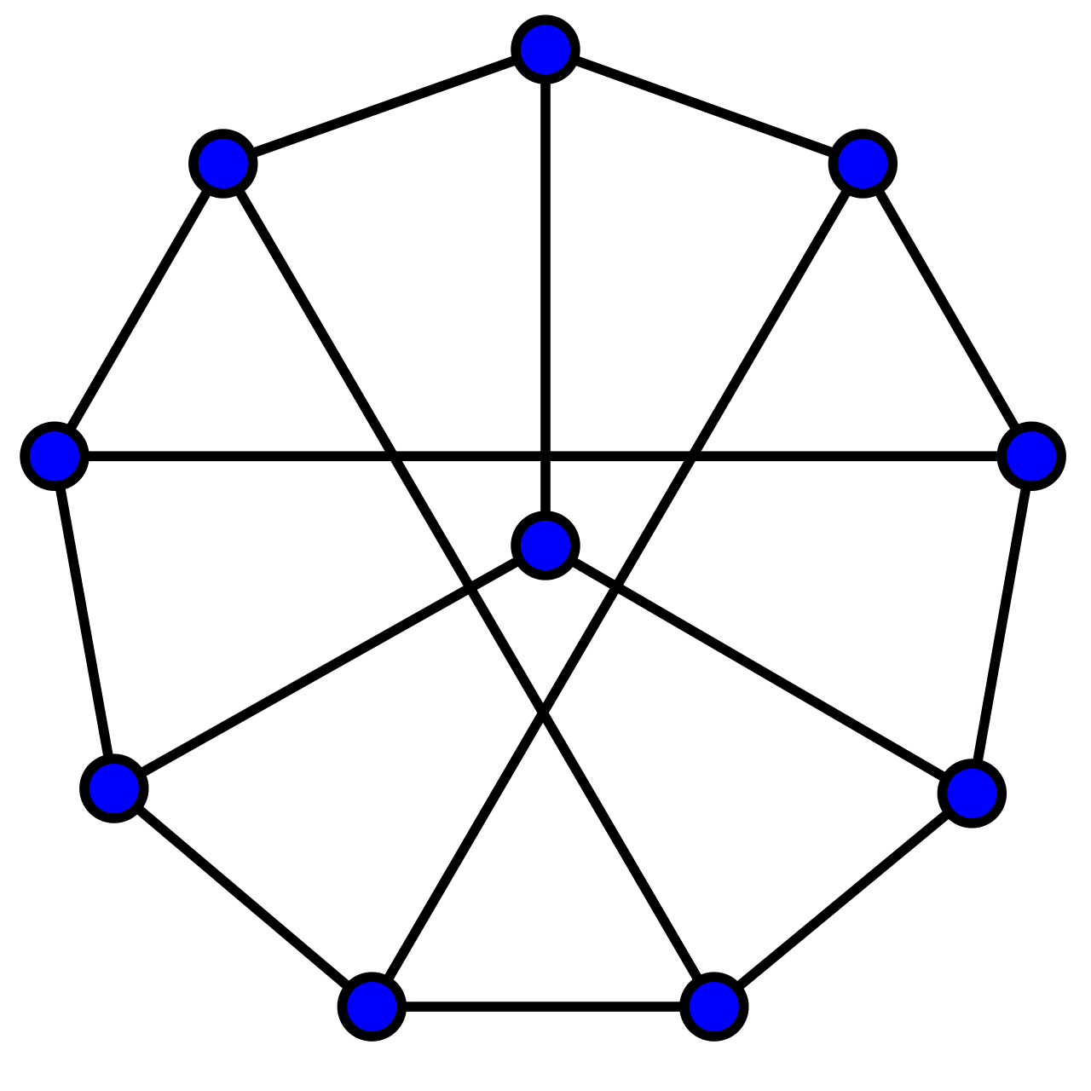
The Petersen Graph
All vertices have degree 3, so this is called a 3-regular graph, or cubic graph.
These two graphs are the same, they are just layed-out differently.
See Wikipedia’s list of graphs for more examples.

Slide 32
Representing Graphs
a
b
f
Adjacency list The graph is a set of vertex pairs
Adjacency matrix The graph is a 2-dimensional table
c
e
d
V = {a, b, c, d, e, f} E = {(a,d), (b, e), (c,d), (c,e)}
E could be a vector of pairs, or a list of pairs, the pairs could be pointers to nodes, etc.

Slide 33
Representing Graphs
a
b
f
Adjacency list The graph is a set of vertex pairs
Adjacency matrix The graph is a 2-dimensional table
c
e
d
 | a | b | c | d | e | f
a | 0 | 0 | 0 | 1 | 0 | 0
b | 0 | 0 | 0 | 0 | 1 | 0
c | 0 | 0 | 0 | 1 | 1 | 0
d | 1 | 0 | 1 | 0 | 0 | 0
e | 0 | 1 | 1 | 0 | 0 | 0
f | 0 | 0 | 0 | 0 | 0 | 0
0 means no edge, 1 means an edge

Slide 34
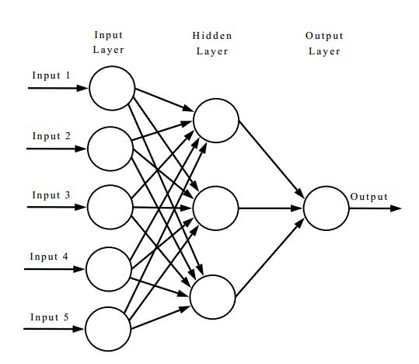
Representing Graphs
Adjacency list The graph is a set of vertex pairs
Adjacency matrix The graph is a 2-dimensional table
15 edges
3 edges
Neural networks are typically represented as graphs with lots of weighted edges. Adjacency matrices are often used to represent them.

Slide 35
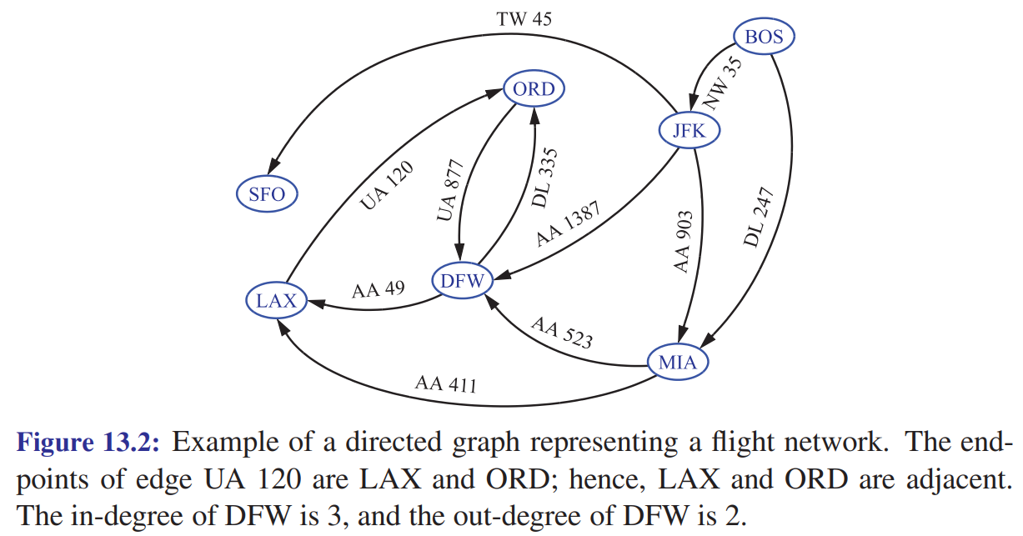
Applications of Graphs: Maps
Vertices are airports, and edges are flights between them.

Slide 36
Depth-first Search of a Graph
C
A high-level description of how we will search graphs.
B
Beginning at a given start node, we want to visit all the nodes in this graph.
We can do this using a container data structure to store nodes we want to visit.
To visit a node, we remove it from the container. We add neighbors of it we haven’t see into an “already visited” table, and add non-visited nodes into the container.
A
D
E
F
The rules for what how we add/remove nodes change the algorithm.
G
H
I

Slide 37
Depth-first Search of a Graph
What order do the nodes get visited when you call Depth-first-search(A)? Trace through the entire call by hand.
Depth-first-search(root)
S = empty stack
visited = {} // hash table
S.push(root)
while not S.empty(): p = S.pop() visit p visited.add(p) for each neighbor n of p: if n not in visited:
S.push(n)
A
B
C
D
E
F
G
H
I
Important Check neighbors in alphabetical order (for this example).

Slide 38
Depth-first Search of a Graph
What order do the nodes get visited when you call Depth-first-search(A)? Trace through the entire call.
Depth-first-search(root)
S = empty stack
visited = {} // hash table
S.push(root)
while not S.empty(): p = S.pop() visit p visited.add(p) for each neighbor n of p: if n not in visited:
S.push(n)
A
B
C
Depth-first visit order: A, D, G, H, E, F, I, B, C
D
E
F
G
H
I
Important Check neighbors in alphabetical order (for this example).

Slide 39
Visualization of Depth First Search from this article.

Slide 40
Breadth-first Search of a Graph
What order do the nodes get visited when you call Breadth-first-search(A)? Trace through the entire call.
Breadth-first-search(root)
S = empty queue
visited = {} // hash table
S.enqueue(root)
while not S.empty(): p = S.dequeue() visit p visited.add(p) for each neighbor n of p: if n not in visited:
S.enqueue(n)
A
B
C
D
E
F
G
H
I
Important Check neighbors in alphabetical order (for this example).

Slide 41
Breadth-first Search of a Graph
What order do the nodes get visited when you call Breadth-first-search(A)? Trace through the entire call.
Breadth-first-search(root)
S = empty queue
visited = {} // hash table
S.enqueue(root)
while not S.empty(): p = S.dequeue() visit p visited.add(p) for each neighbor n of p: if n not in visited:
S.enqueue(n)
A
B
C
Breadth-first visit order: A, B, D, E, C, G, F, H, I
D
E
F
G
H
I
Important Check neighbors in alphabetical order (for this example).

Slide 42
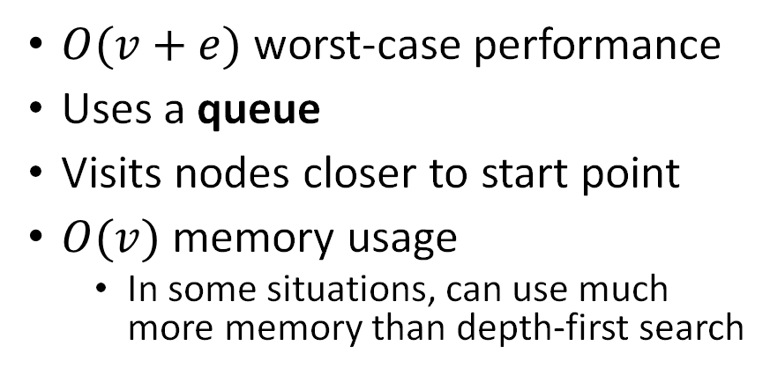
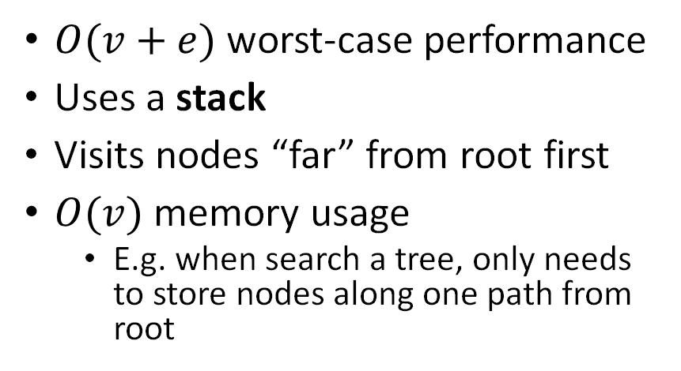
Depth-first vs Breadth-first Search
Depth-first Search
Breadth-first Search
$O(v+e)$worst-case performance
Uses a stack
Visits nodes “far” from root first
$O(v)$memory usage
E.g. when search a tree, only needs to store nodes along one path from root
$O(v+e)$worst-case performance
Uses a queue
Visits nodes closer to start point
$O(v)$memory usage
In some situations, can use much more memory than depth-first search
E.g. you could of depth-first search until you find a region of interest, then switch to breadth-first.
Many different variations of these search algorithms!
E.g. for some graphs (e.g. trees) you may be able to get rid of the visited list, thus saving memory

Slide 43
Visualization of Breadth First Search from this article.

Slide 44
Depth First Search
Breadth First Search

Slide 45
Shortest paths
What is the adjacency matrix representation of this graph?
3
1
A
B
C
1
1
5
D
6
E
1
F
1
1
1
G
2
H
4
I
The numbers on the edges represent weights, e.g. the cost of moving between the two given nodes.

Slide 46
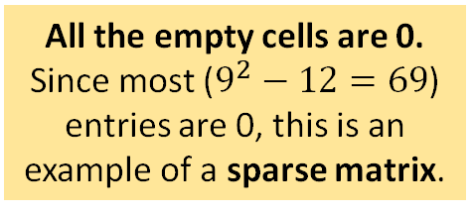
Shortest paths
What is the adjacency matrix representation of this graph?
3
1
9x9 matrix
A
B
C
 | A | B | C | D | E | F | G | H | I
A | 0 | 3 |  | 1
B |  | 0 | 1
C |  |  | 0 |  |  | 5
D |  |  |  | 0 | 6 |  | 1
E |  | 1 |  |  | 0 |  | 1
F |  |  |  |  |  | 0 |  |  | 1
G |  |  |  |  |  |  | 0 | 2
H |  |  |  |  | 1 |  |  | 0 | 4
I |  |  |  |  |  |  |  |  | 0
1
1
5
D
6
E
1
F
1
1
1
G
2
H
4
I
The numbers on the edges represent weights, e.g. the cost of moving between the two given nodes.
All the empty cells are 0. Since most ($9^{2}−12=69$) entries are 0, this is an example of a sparse matrix.

Slide 47
Shortest paths
start
What is the cost of the path A → B → C → F → I ?
3
1
A
B
C
1
1
5
D
6
E
1
F
1
1
1
G
2
H
4
I
end
The numbers on the edges represent weights, e.g. the cost of moving between the two given nodes.

Slide 48
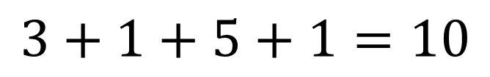
Shortest paths
start
What is the cost of the path A → B → C → F → I ?
3
1
A
B
C
1
1
5
$$3+1+5+1=10$$
D
6
E
1
F
Is there a shorter path from start to end? If so, what is it, and what is its weight?
1
1
1
G
2
H
4
I
end
The numbers on the edges represent weights, e.g. the cost of moving between the two given nodes.

Slide 49
Shortest paths
start
3
1
A
B
C
1
1
5
A → D → G → H → E → F → I cost: 1 + 1 + 2 + 1 + 1 + 1 = 7
D
6
E
1
F
1
1
1
Can we come up with an algorithm that will find the lowest-cost path between any two nodes of a weighted graph?
G
2
H
4
I
end
The numbers on the edges represent weights, e.g. the cost of moving between the two given nodes.

Slide 50

Dijkstra’s Shortest Path Algorithm
start
3
1
A
B
C
Beginning at a given start node, finds the shortest path from start (and all other nodes in the graph, if you want)
Edge weights must be non-negative
At each node v we will store dist[v], the cost of the lowest-cost path (so far) from start, and a back-pointer to keep track of shortest paths
Dijkstra’s algorithm is a kind of breadth-first search, using a priority queue instead of a regular queue
1
1
5
D
6
E
1
F
1
1
1
G
2
H
4
I
end

Slide 51
Dijkstra’s Algorithm
This version of Dijkstra’s algorithm is based on the one in Wikipedia.
All dist values are initialized to their max possible value.
Algorithm Dijkstra(G, start_node) for each vertex v in G.vertices: dist[v] = +INFINITY prev[v] = nullptr dist[start_node] = 0
PQ = G.vertices
while PQ.size() > 0:
u = vertex in PQ with min dist[u]
remove u from PQ
for each neighbor v of u still in PQ:
alt = dist[u] + G.edge(u, v)
if alt < dist[v]:
dist[v] = alt
prev[v] = u
return dist, prev
PQ is a priority queue, where the key for a vertex is its dist[v] value
dist[v] is the cost of the shortest path from start_node to v
prev[v] is a pointer to the previous node in a shortest path from start_node to v
following prev pointers you can walk from v back to start_node

Slide 52
Dijkstra’s Algorithm
Trace Disjkstra’s algorithm through all nodes on this graph.
Algorithm Dijkstra(G, start_node) for each vertex v in G.vertices: dist[v] = +INFINITY prev[v] = nullptr dist[start_node] = 0
PQ = G.vertices
while PQ.size() > 0:
u = vertex in PQ with min dist[u]
remove u from PQ
for each neighbor v of u still in PQ:
alt = dist[u] + G.edge(u, v)
if alt < dist[v]:
dist[v] = alt
prev[v] = u
return dist, prev
start
3
1
A
B
C
1
1
5
D
6
E
1
F
1
1
1
G
2
H
4
I
end

Slide 53
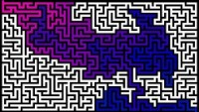
Solving a Maze with Dijkstra’s Algorithm

Slide 54
Correctness of Dijkstra’s Algorithm
See Proposition 13.23 of the textbook
It’s a proof by contradiction.
Many bookkeeping details! …

Slide 55
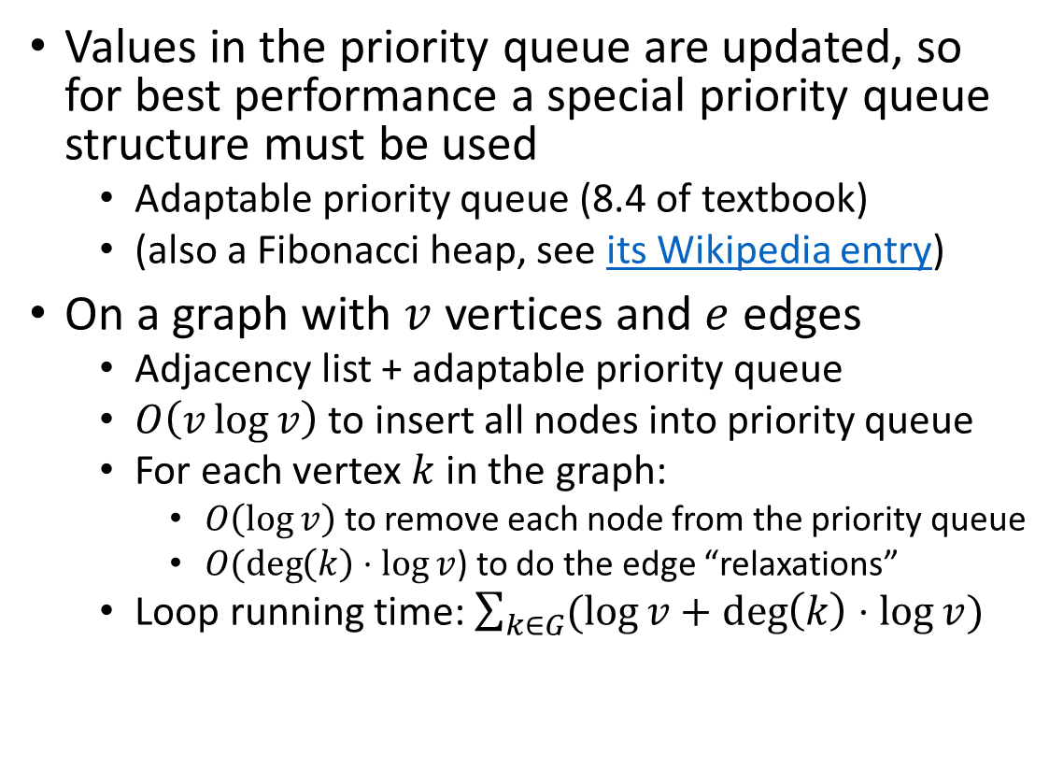
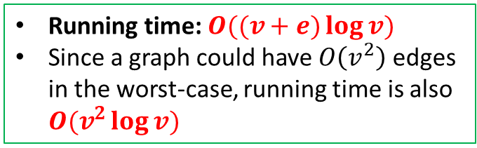
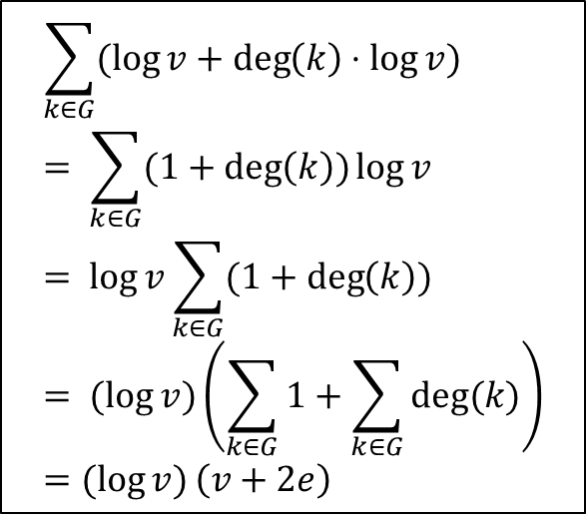
Dijkstra’s Algorithm Performance
Values in the priority queue are updated, so for best performance a special priority queue structure must be used
Adaptable priority queue (8.4 of textbook)
(also a Fibonacci heap, see its Wikipedia entry)
On a graph with $v$ vertices and $e$ edges
Adjacency list + adaptable priority queue
$O\left(v\log{v}\right)$ to insert all nodes into priority queue
For each vertex $k$ in the graph:
$O\left(\log{v}\right)$ to remove each node from the priority queue
$O(\deg\left(k\right)⋅\log{v}$) to do the edge “relaxations”
Loop running time: $\sum_{k∈G}{(\log{v}+\deg\left(k\right)⋅\log{v})}$
$$\sum_{k∈G}{(\log{v}+\deg\left(k\right)⋅\log{v})} \\ = \sum_{k∈G}{(1+\deg\left(k\right))\log{v}} \\ = \log{v}\sum_{k∈G}{(1+\deg\left(k\right))} \\ = (log{v})\left(\sum_{k∈G}{1+\sum_{k∈G}{deg⁡(k)}}\right) \\ =(\log{v)}\left(v+2e\right)$$
Running time: $O((v+e)\log{v})$
Since a graph could have $O\left(v^{2}\right)$ edges in the worst-case, running time is also $O(v^{2}\log{v})$
Handshake Lemma sum of degrees of all vertices is twice the number of edges

Slide 56
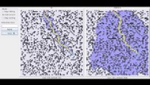
Dijkstra’s Algorithm vs A* Search
A*-search is a modification of Disjktra’s algorithm that uses a heuristic function to make better choices about which node to visit next. A*-search is often used for path-finding in video games, or searching in symbolic AI.

